Slide 1
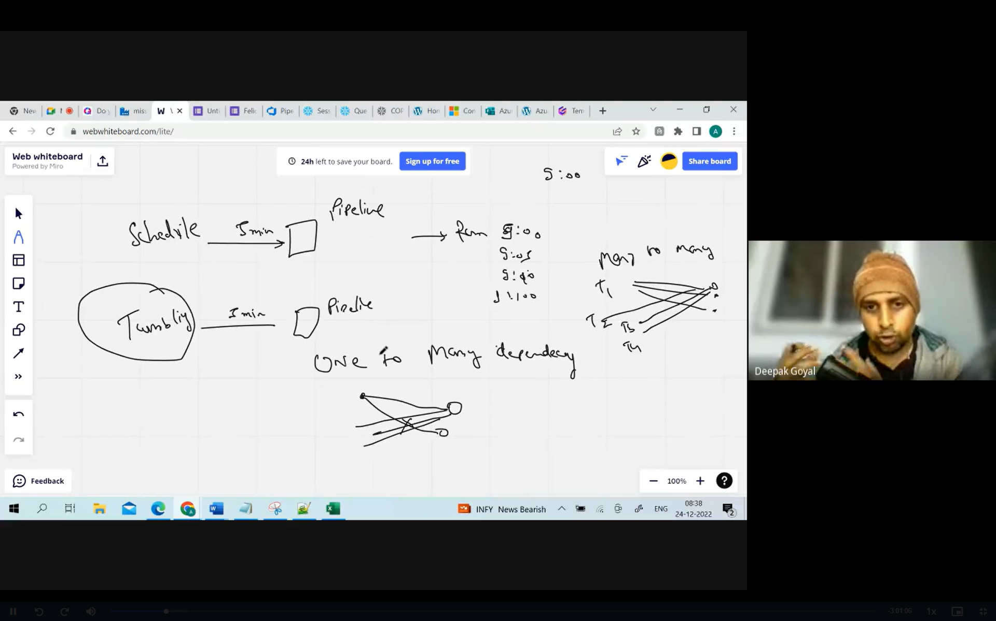
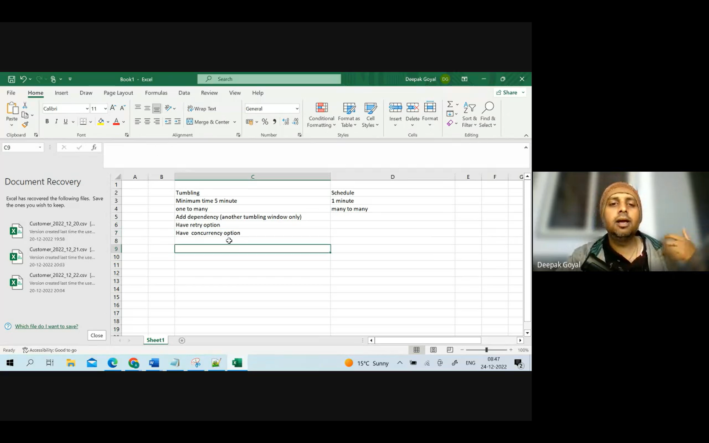

Slide 2
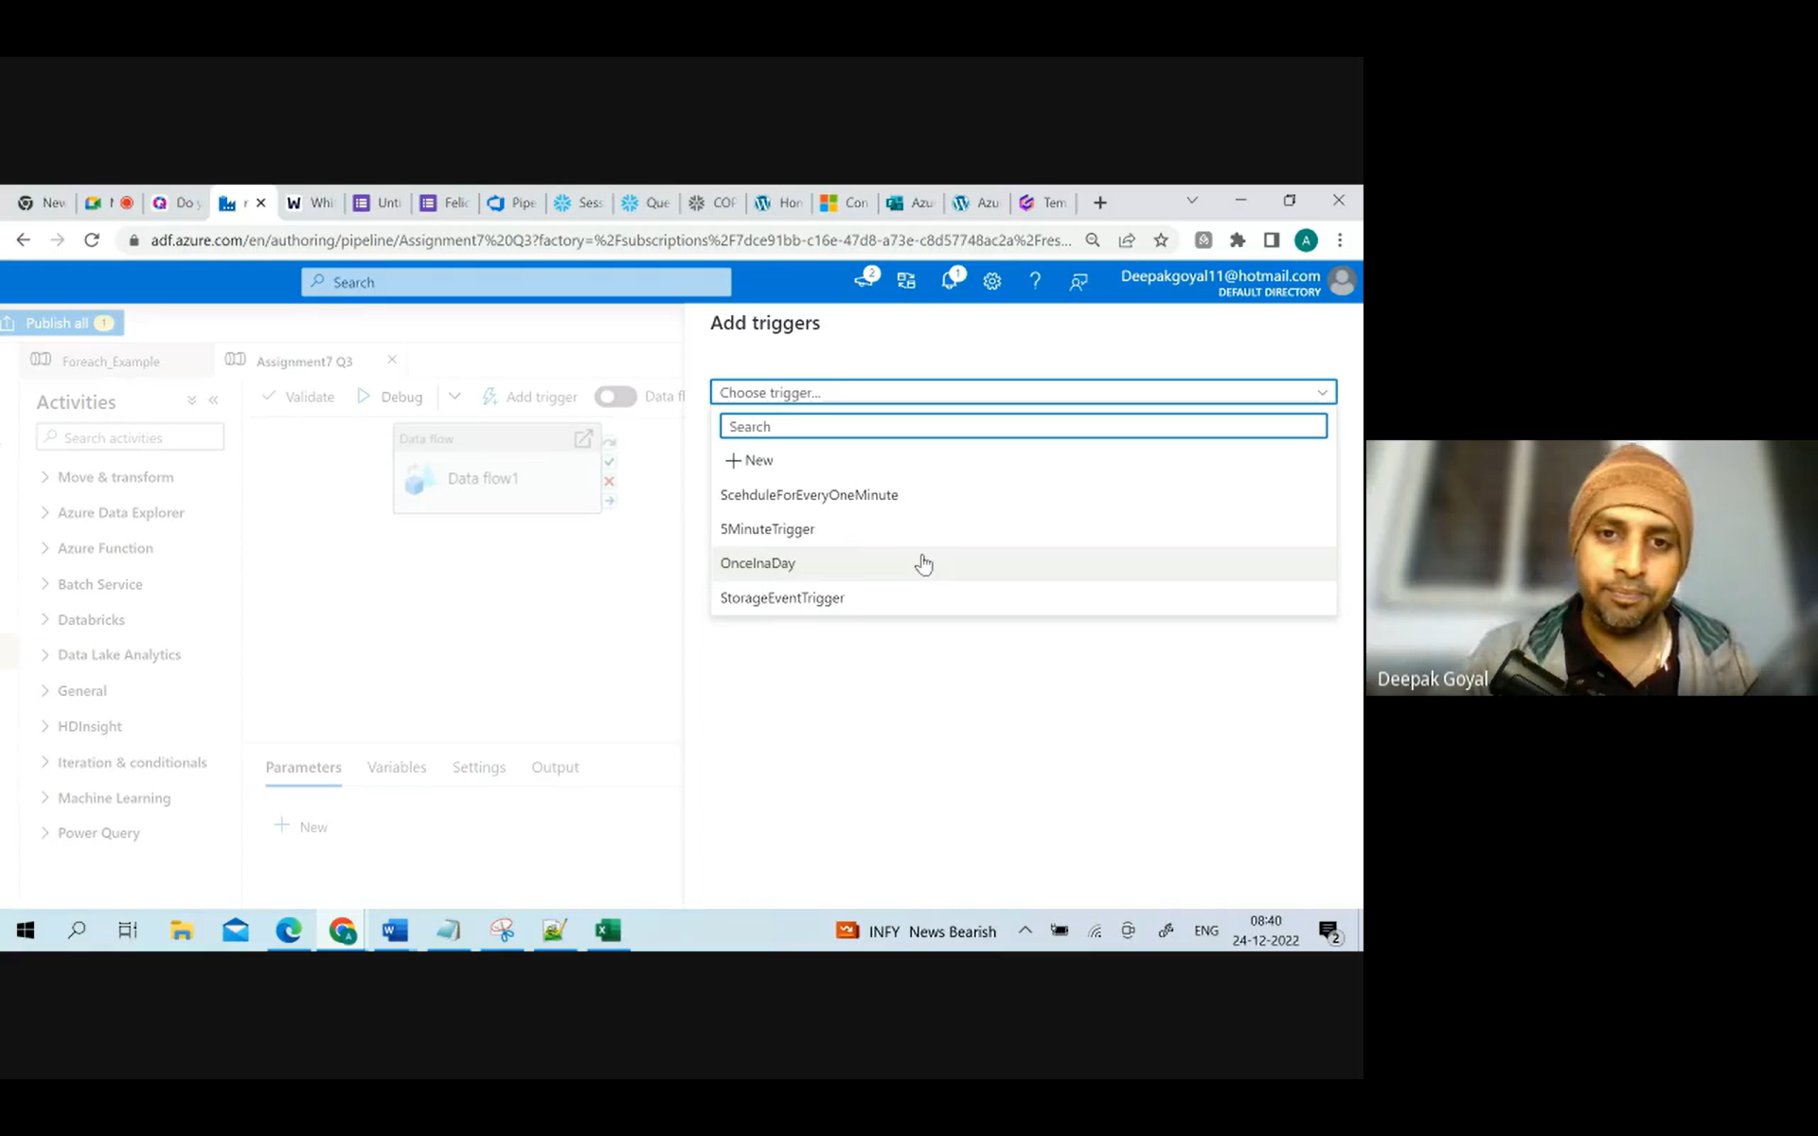
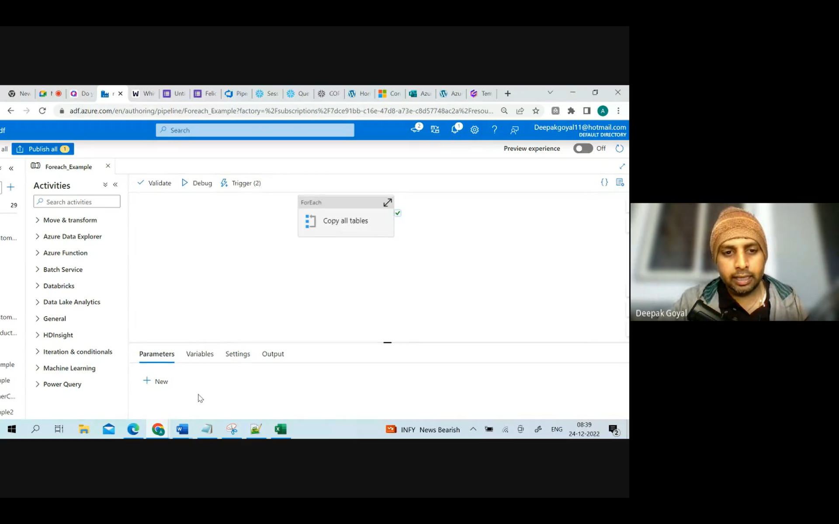
Trigger has already been associated to one of the pipeline. you will not get the option of tumbling window trigger.
One Pipeline have 2 Triggers
Triggers:
Tumbling window trigger
Schedule trigger

Slide 3
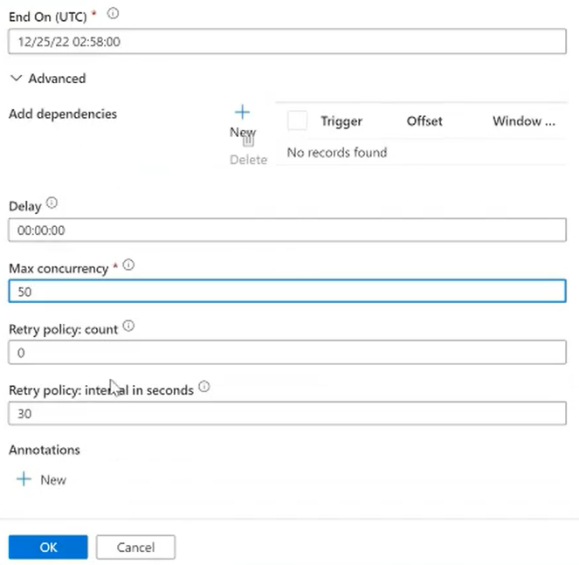

Slide 4
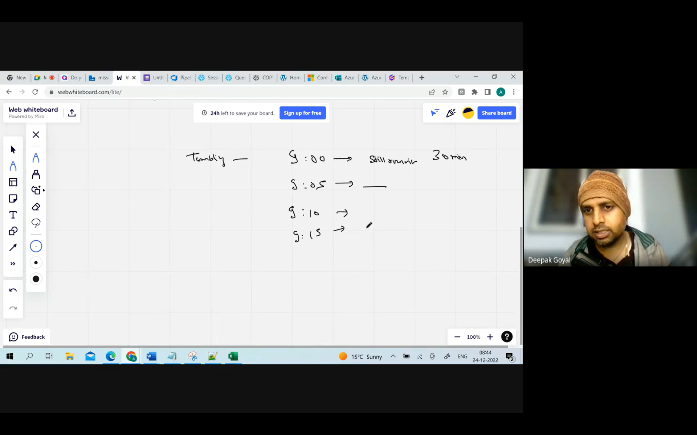
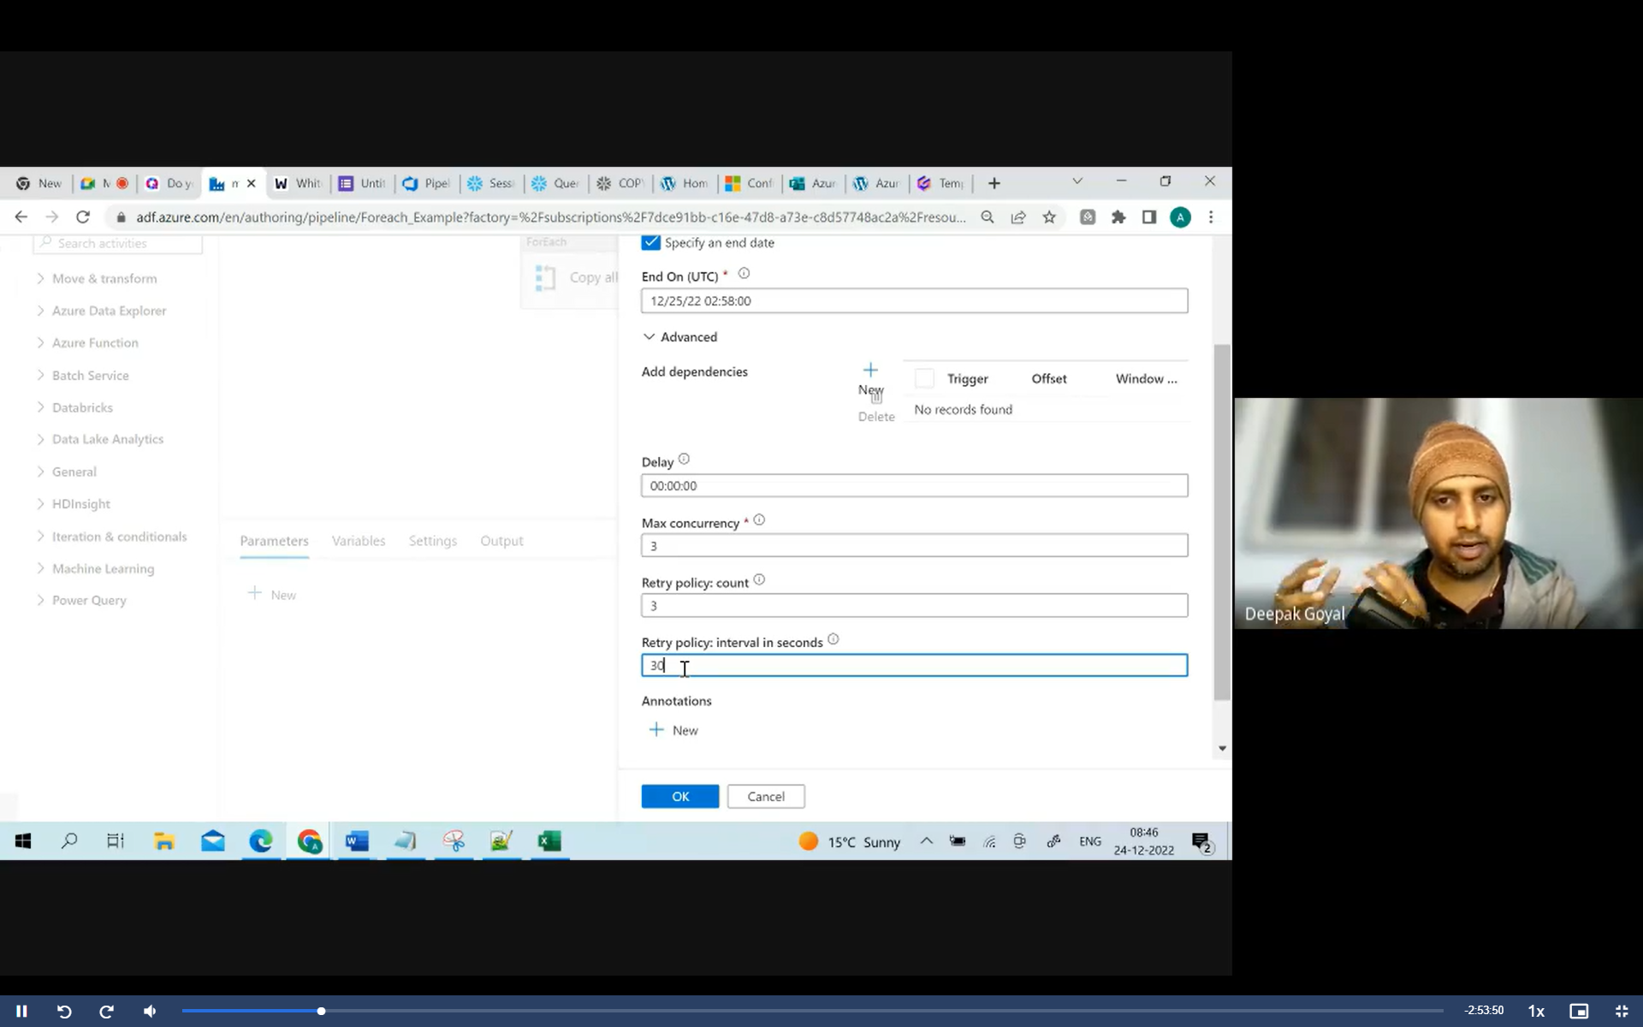
3 instances running, should I start 4 or not?
If your pipeline got failed, automatically retry my execution after every 30 sec with 3 times retry.

Slide 5
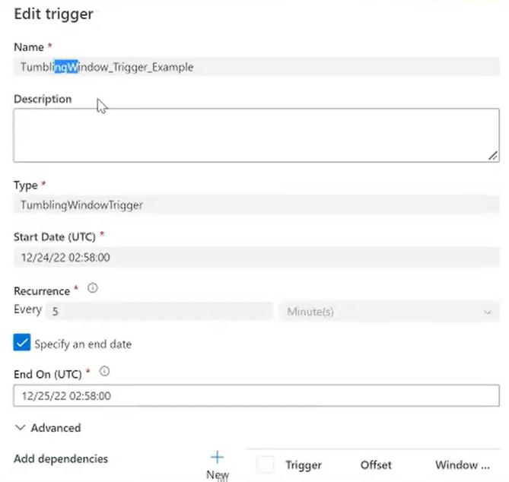

Slide 6
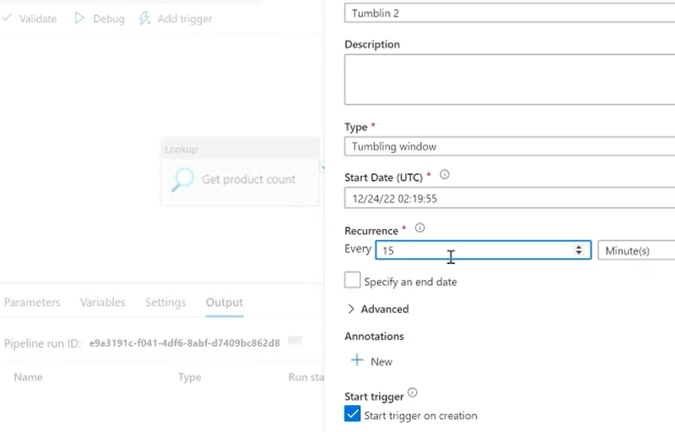
1 hr early time entered (Current time is 03:19:55)

Slide 7
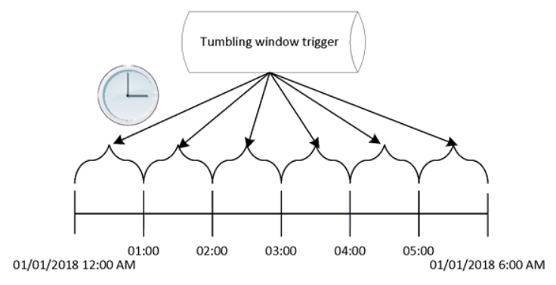

Slide 8
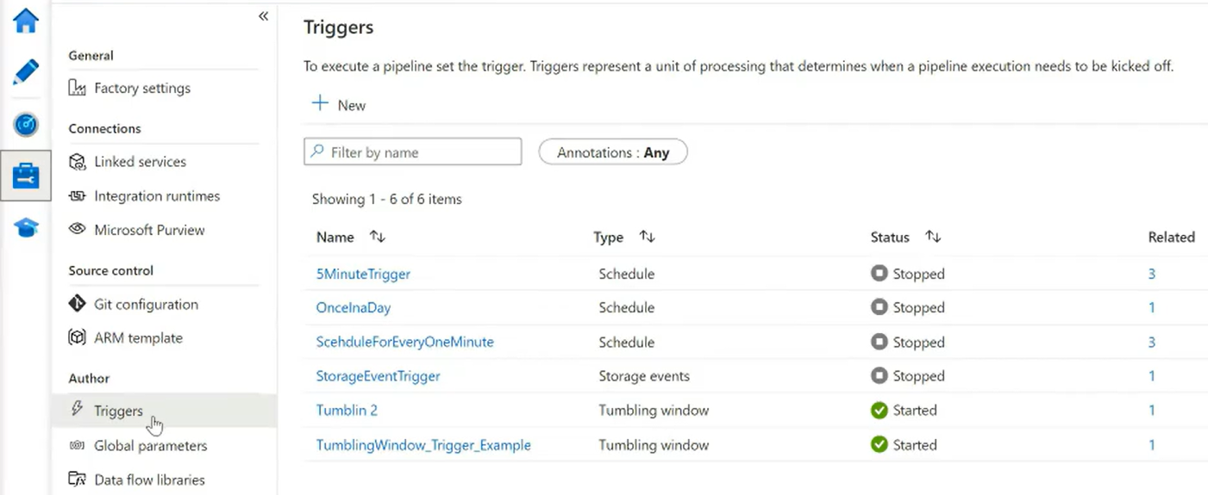

Slide 9
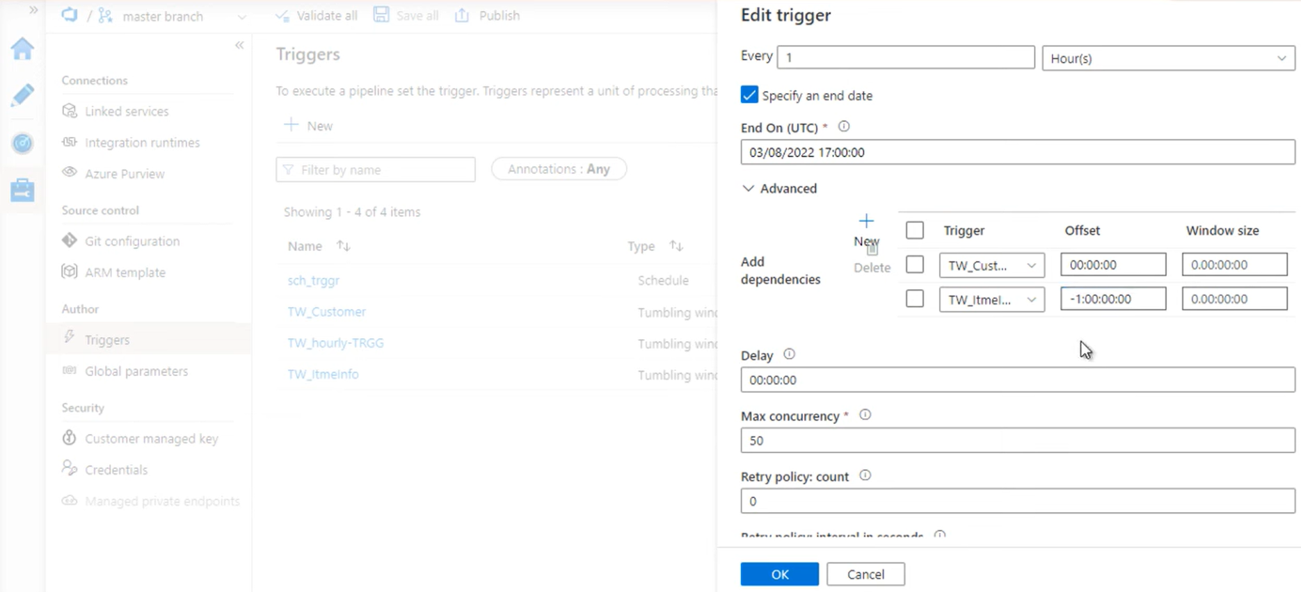
-ve value for self dependency

